Slide 1
Healthcare Appointment
& Care Analytics
Patient Portal
Final Capstone Presentation
Admin Dashboard
ASP.NET Core MVC + Web API + SQL Server + JWT + EF Core + ADO.NET
JWT-secured API
Business Objective
Improve care delivery by making patient profiles, appointment booking, secure API access, audit logging, and reporting available in one layered healthcare platform.
SQL Analytics
Core Entities
Presented by: Rithin Vishwas
Domain: Healthcare Analytics Platform
Patient · Appointment · Doctor · Department · AppUser · AppRole · AuditLog · MedicalRecord
Capstone Final Presentation • ASP.NET Core MVC + Web API + SQL Server
Secure · Layered · Database-driven · API-ready

Slide 2
Healthcare Appointment & Care Analytics
Slide 2 / 18
1. Problem Statement & Business Objective
Why this system is required for a healthcare appointment environment.
Business Problem
Project Objective
Expected Outcome
Manual appointment handling leads to missed follow-ups, slot conflicts, and poor visibility across patients, doctors, and care delivery operations.
Build a secure, database-driven system where Admins can manage records and Patients can register, create profiles, and book appointments.
A working MVC portal, JWT-secured Web API, normalized SQL database, reporting views, audit logs, and deployment-ready DevOps assets.
Challenges Solved
Project Success Criteria
• Duplicate doctor time slots are blocked • Patient and appointment data stored centrally • Admin and Patient users have separate secure flows • API clients can test endpoints through Swagger • Reports provide appointment and workload visibility
• MVC UI works end-to-end with SQL Server • JWT login and protected APIs return expected responses • SQL tables, views, triggers, stored procedures are available • Role-based authorization protects admin and user flows • SME demo can trace UI → Controller → Service → DB
Capstone Final Presentation • ASP.NET Core MVC + Web API + SQL Server
Secure · Layered · Database-driven · API-ready

Slide 3
Healthcare Appointment & Care Analytics
Slide 3 / 18
2. Scope & Capstone Deliverables
How the project maps to the expected final submission rubric.
Source Code
Frontend UI
Layered C# solution with MVC, Web API, Core, Infrastructure, and Tests projects.
Razor Views, ViewModels, validation, layout, dashboard, patient portal, and AJAX-ready flow.
Database
Security
DDL, DML, views, triggers, stored procedures, EF Core DbContext and SQL scripts.
JWT, cookie authentication, role authorization, anti-forgery, validation, security headers.
DevOps & AI
Documentation
Dockerfiles, compose, GitHub Actions YAML, Copilot prompt log, and AI/MCP concept.
Architecture, DFD, ERD, database design, API documentation, business rules, final demo script.
Capstone Final Presentation • ASP.NET Core MVC + Web API + SQL Server
Secure · Layered · Database-driven · API-ready

Slide 4
Healthcare Appointment & Care Analytics
Slide 4 / 18
3. Main Modules and User Roles
Functional decomposition of the Healthcare Appointment & Care Analytics platform.
Authentication
Patient Portal
Admin Dashboard
Admin login, user registration, cookie auth, JWT login, password hashing, role checks
Create patient profile, book appointment, view only own appointments
View patients, doctors, appointments, reports, and management screens
Appointment Engine
Analytics Reports
API Layer
Doctor schedule validation, duplicate slot prevention, status update
Dashboard counts, upcoming appointments, doctor workload, SQL reports
Swagger-tested REST endpoints protected through Bearer tokens
Role Split
Module Boundaries
• Admin: dashboard, patient/appointment management, reports • User/Patient: register, create profile, book appointment, view own appointments • API Client: login, authorize with JWT, consume protected endpoints
• MVC handles human-friendly UI • API handles mobile/Postman/Swagger access • Core contains entities/DTOs/interfaces • Infrastructure handles EF Core, repositories, services, SQL access
Capstone Final Presentation • ASP.NET Core MVC + Web API + SQL Server
Secure · Layered · Database-driven · API-ready

Slide 5
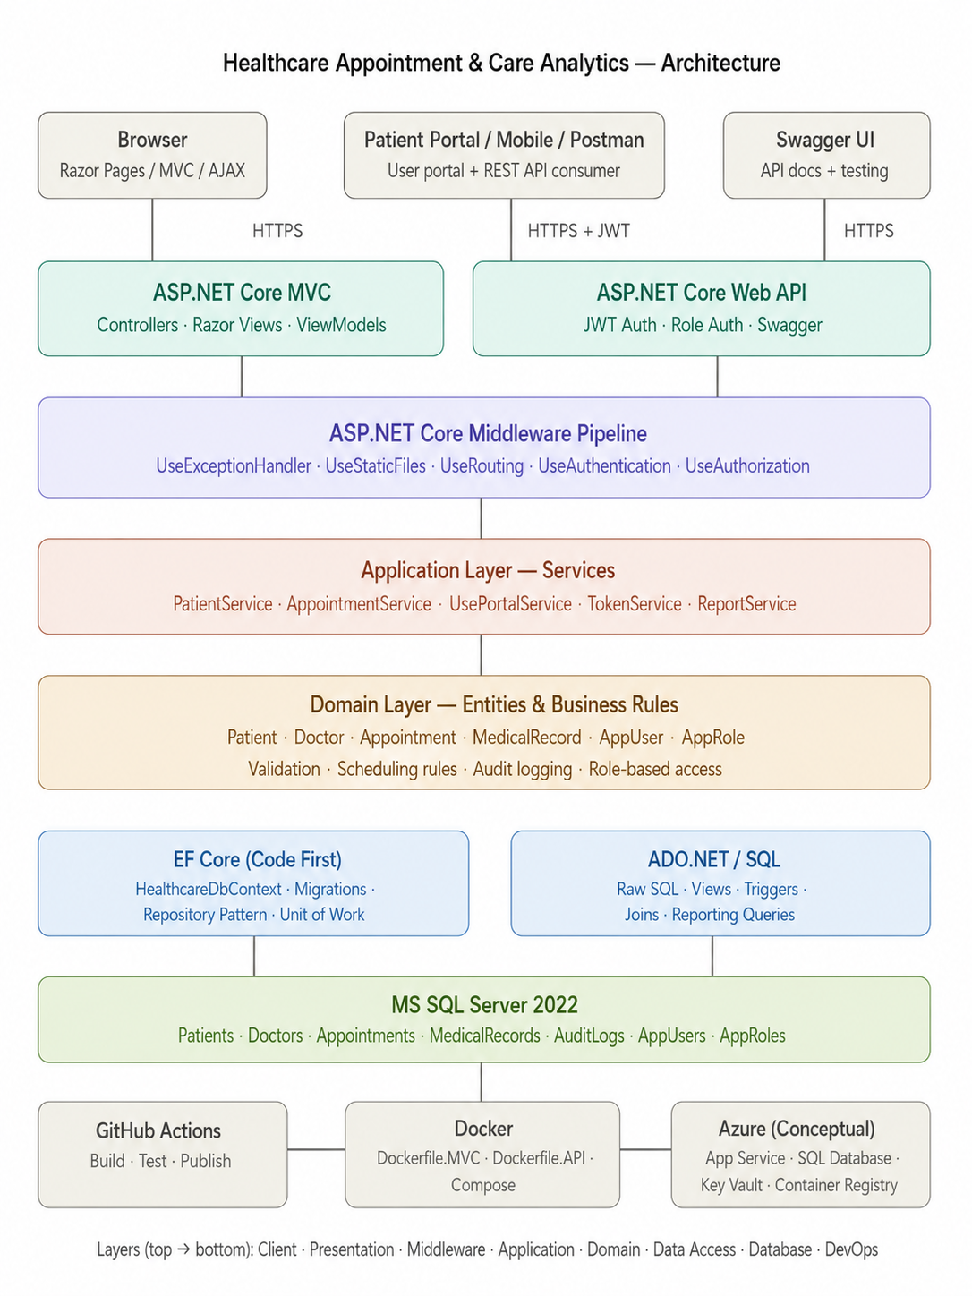
Healthcare Appointment & Care Analytics
Slide 5 / 18
4. System Architecture
Layered view from client interfaces to SQL Server and DevOps assets.
Capstone Final Presentation • ASP.NET Core MVC + Web API + SQL Server
Secure · Layered · Database-driven · API-ready

Slide 6
Healthcare Appointment & Care Analytics
Slide 6 / 18
5. End-to-End Walkthrough: UI to Database
Working demo path proving MVC, services, EF Core, SQL Server, and audit flow.
1
Login
2
Profile
Admin/User enters credentials and role is verified
User creates patient profile linked through AppUsers.PatientId
3
Book
4
Validate
User selects doctor, date/time, duration, and reason
ViewModel + service checks required fields and duplicate slot
5
Persist
6
Audit
Repository + EF Core saves the appointment record
SQL trigger inserts appointment audit information
7
Report
Output checks:
MVC: Login → Dashboard → Patient Profile → Book Appointment
SQL Server: Patients/Appointments/AuditLogs updated
Swagger: GET /api/Appointments returns 200 OK
Dashboard/report page reads analytics through views/procs
Capstone Final Presentation • ASP.NET Core MVC + Web API + SQL Server
Secure · Layered · Database-driven · API-ready

Slide 7
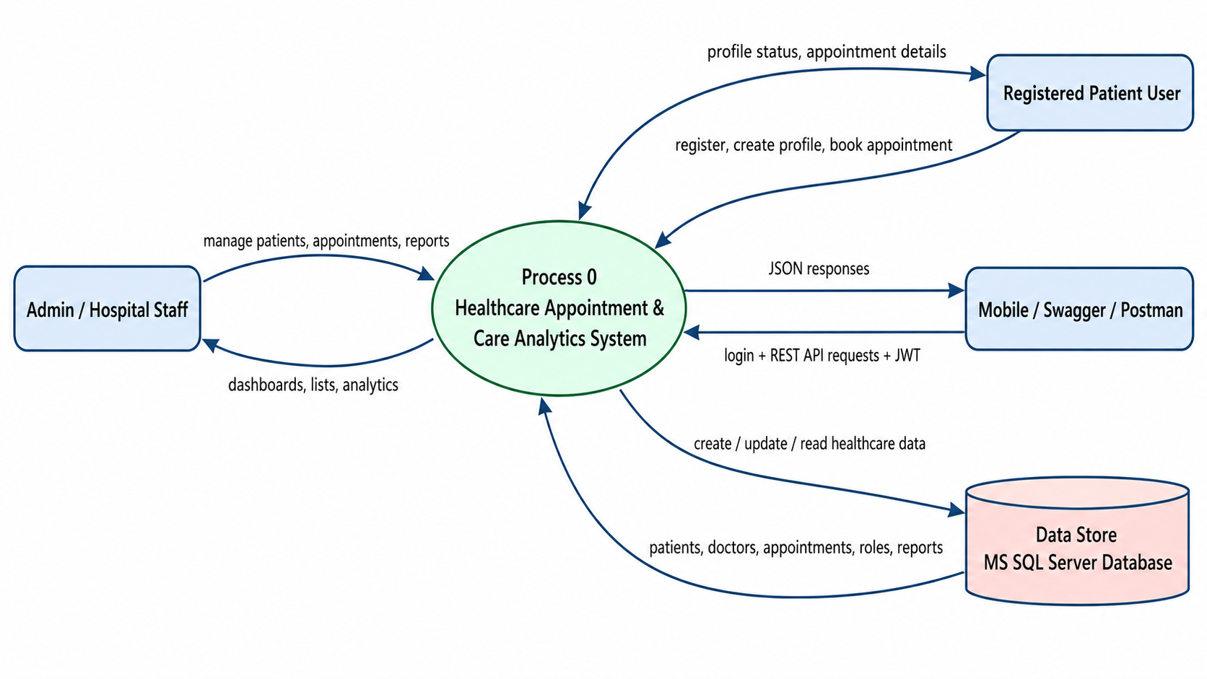
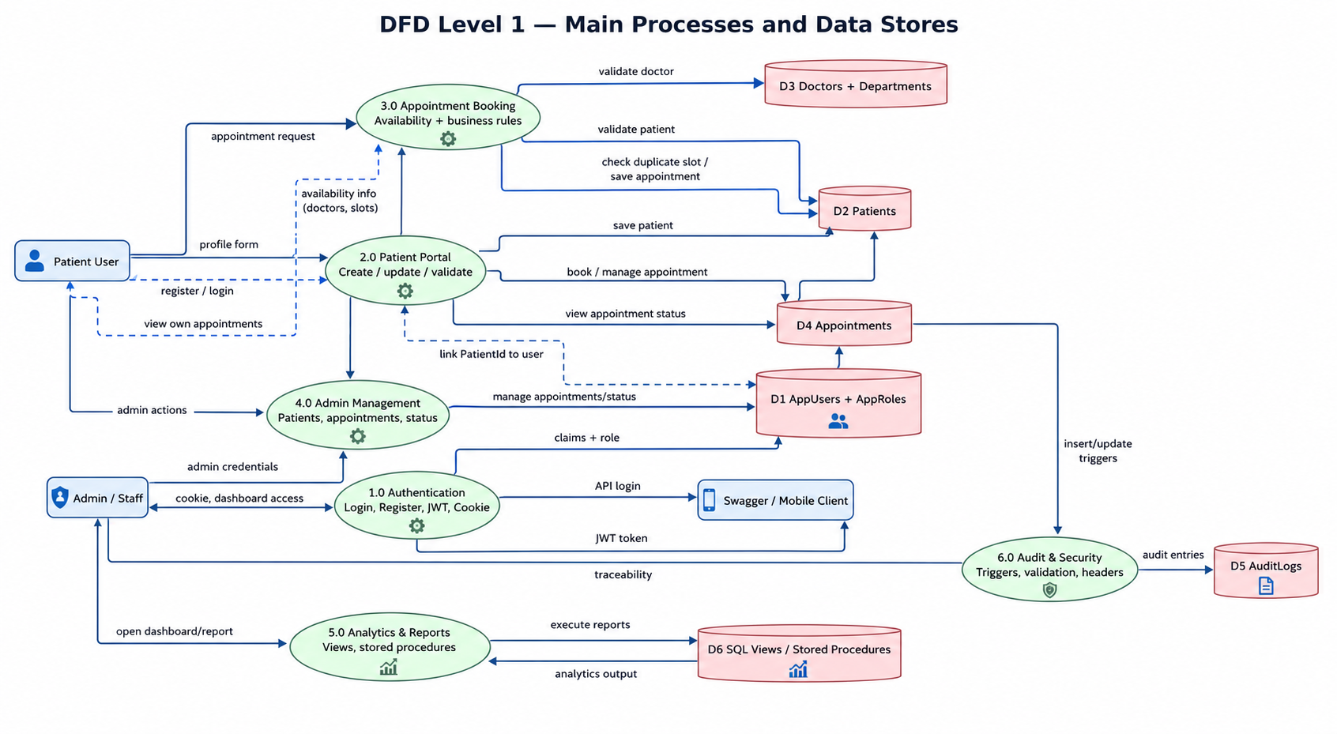
Healthcare Appointment & Care Analytics
Slide 7 / 18
6. DFD: Context and Internal Data Flow
Data movement among actors, system processes, and SQL Server stores.
What the DFD proves
Presentation explanation
• Actors: Admin, Patient/User, API client • Processes: Authentication, patient profile, appointment booking, reporting, audit logging • Data stores: AppUsers, Patients, Doctors, Appointments, AuditLogs • Outputs: dashboard counts, reports, JSON API responses, appointment confirmation
• Level 0 shows the complete system boundary • Level 1 breaks the system into internal processes • Every data write travels through validation before SQL Server • Audit data supports accountability and traceability
Capstone Final Presentation • ASP.NET Core MVC + Web API + SQL Server
Secure · Layered · Database-driven · API-ready

Slide 8
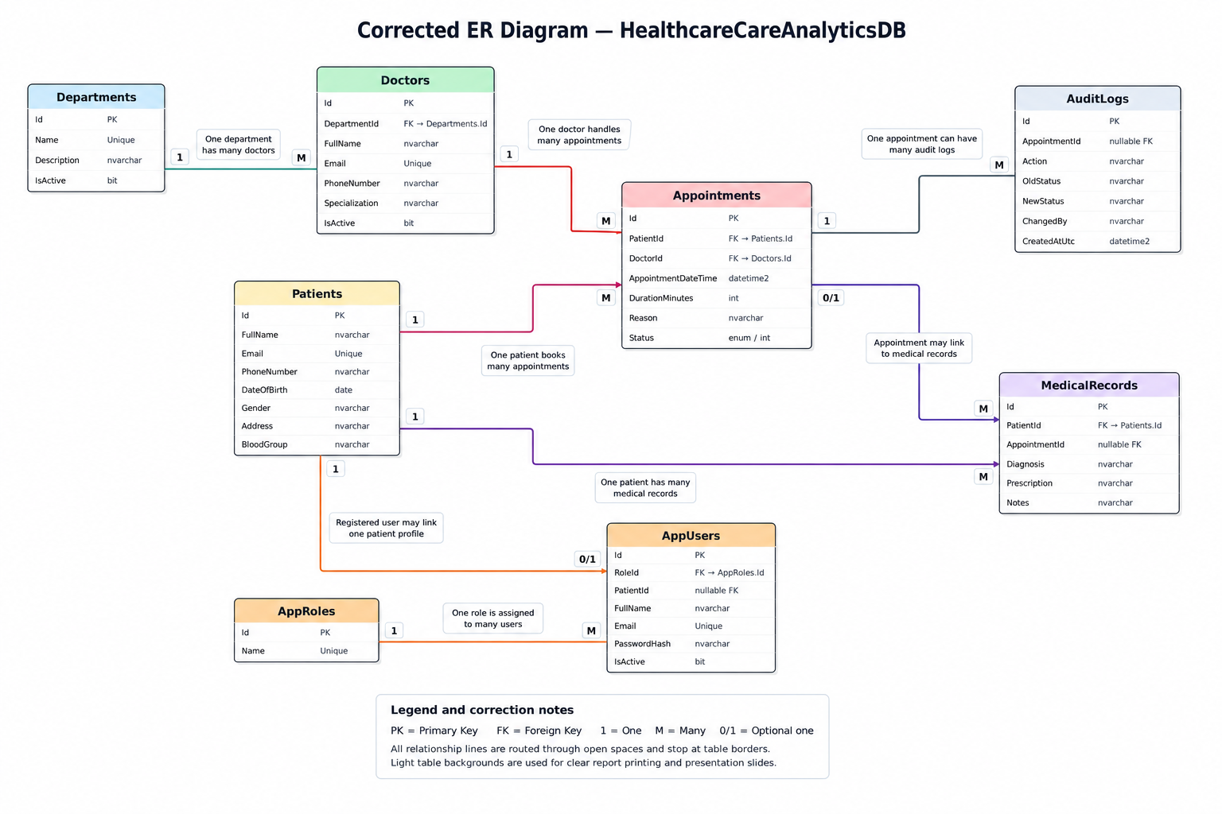
Healthcare Appointment & Care Analytics
Slide 8 / 18
7. ER Diagram: Healthcare Data Model
Normalized relationships between users, patients, doctors, appointments, and audit records.
Main relationships
• Department → many Doctors • Doctor → many Appointments • Patient → many Appointments • Patient → many MedicalRecords • Appointment → many AuditLogs • AppRole → many AppUsers • AppUser may link one Patient profile
Why this design works
• Avoids duplicate patient/doctor data • Preserves appointment history • Supports user portal with PatientId link • Keeps audit log separate from appointment data • Supports reporting and future medical record expansion
Capstone Final Presentation • ASP.NET Core MVC + Web API + SQL Server
Secure · Layered · Database-driven · API-ready

Slide 9
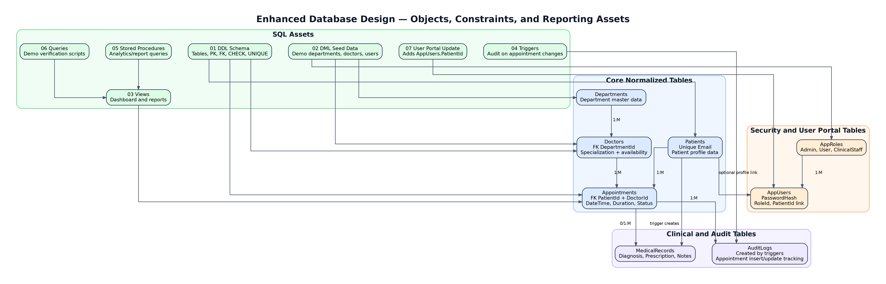
Healthcare Appointment & Care Analytics
Slide 9 / 18
8. Database Design & SQL Artifacts
MS SQL Server design supports normalization, reporting, triggers, and auditing.
Database highlights
Execution order
• Database: HealthcareCareAnalyticsDB • Core tables: Patients, Doctors, Appointments, MedicalRecords • Security tables: AppUsers, AppRoles, PasswordHash • Constraints: PK, FK, Unique, nullable FK, status enum/int • Triggers write audit information for appointments • Views/stored procedures support dashboard reports
• 01_ddl_schema.sql • 02_dml_seed_data.sql • 03_views.sql • 04_triggers.sql • 05_stored_procedures.sql • 06_queries.sql • 07_user_portal_update.sql
Capstone Final Presentation • ASP.NET Core MVC + Web API + SQL Server
Secure · Layered · Database-driven · API-ready

Slide 10
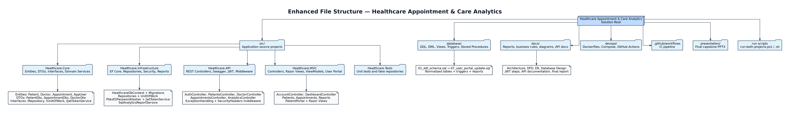
Healthcare Appointment & Care Analytics
Slide 10 / 18
9. File Structure: Layered Solution
Clean separation keeps responsibilities easy to understand, test, and maintain.
Healthcare.API
Healthcare.MVC
Healthcare.Core
REST endpoints, JWT authentication, Swagger, controllers, DTO responses
Razor UI, controllers, views, ViewModels, cookie login, user portal
Entities, DTOs, interfaces, enums, exceptions, business contracts
Healthcare.Infrastructure
database
devops/tests/docs (Conceptual)
EF Core DbContext, repositories, services, token/password services
DDL, DML, views, triggers, stored procedures, queries, portal update
Docker, GitHub Actions, xUnit tests, diagrams, report, walkthrough
Capstone Final Presentation • ASP.NET Core MVC + Web API + SQL Server
Secure · Layered · Database-driven · API-ready

Slide 11
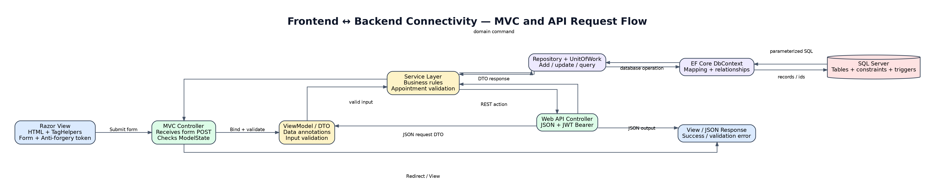
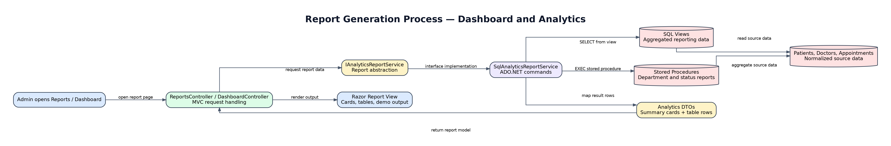
Healthcare Appointment & Care Analytics
Slide 11 / 18
10. Frontend–Backend Connectivity & Report Generation
How MVC/API requests pass through validation, services, repositories, and SQL reporting assets.
MVC connectivity flow
Report generation flow
• Razor View submits form using tag helpers • Controller receives ViewModel and checks ModelState • Service applies business rules such as duplicate slot check • Repository/Unit of Work persists through EF Core • SQL Server stores and returns data to the view
• Dashboard/ReportsController requests analytics • ReportService or ADO.NET executes stored procedure/view • SQL Server calculates counts and workload data • Result is projected into report ViewModel • Dashboard cards/tables display the output
Capstone Final Presentation • ASP.NET Core MVC + Web API + SQL Server
Secure · Layered · Database-driven · API-ready

Slide 12
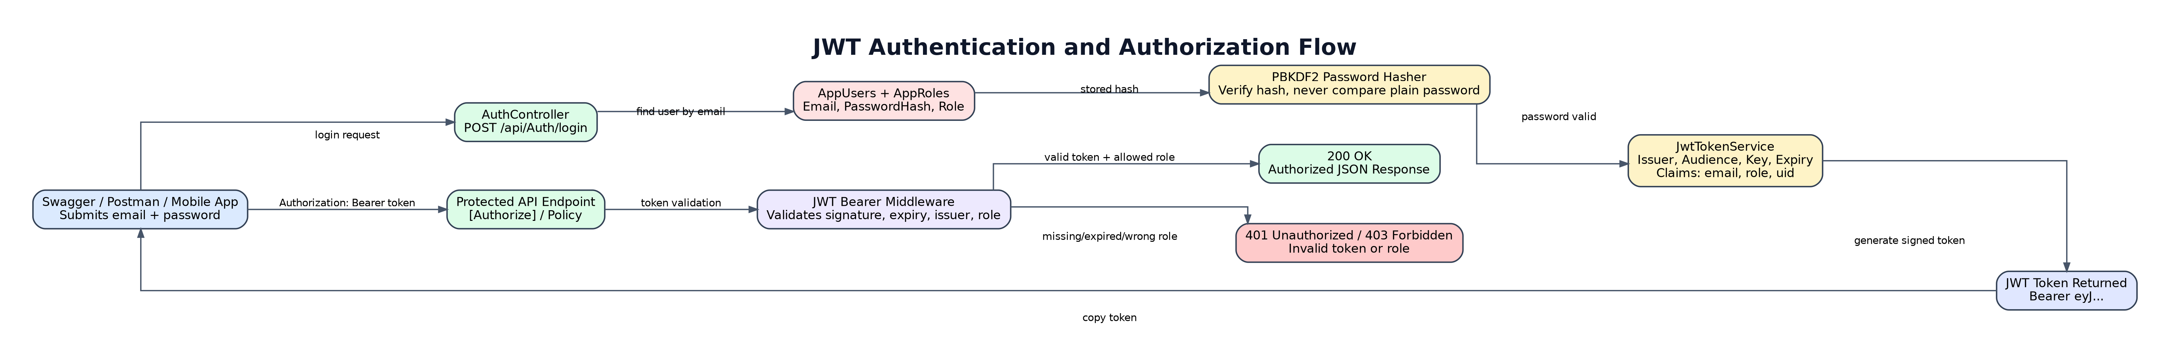
Healthcare Appointment & Care Analytics
Slide 12 / 18
11. API Documentation & JWT Testing
Swagger exposes REST endpoints and verifies protected access using Bearer tokens.
Swagger groups
JWT test steps
GET /api/Doctors → 200 OK
GET /api/Appointments → 200 OK
{
"patientId": 1,
"doctorId": 1,
"reason": "General Checkup"
}
Auth
Patients
Doctors
Appointments
Analytics
1. POST /api/Auth/login
2. Copy token
3. Authorize: Bearer <token>
4. Test protected endpoints
5. Confirm 401 without token
Capstone Final Presentation • ASP.NET Core MVC + Web API + SQL Server
Secure · Layered · Database-driven · API-ready

Slide 13
Healthcare Appointment & Care Analytics
Slide 13 / 18
12. MVC Screenshots and Output Evidence
Screenshots to capture while demonstrating the working application flow.
Admin screenshots
User portal screenshots
• MVC running in terminal • Login page with admin credentials • Admin dashboard with cards and reports • Patient list and create patient form • Appointment booking form and appointment list • SQL Server verification: Patients, Appointments, AuditLogs
• Registration page and validation messages • User login and patient portal dashboard • Create patient profile form • Book appointment as user • My Appointments page shows only user-specific records • SQL Server link: AppUsers.PatientId → Patients.Id
Capstone Final Presentation • ASP.NET Core MVC + Web API + SQL Server
Secure · Layered · Database-driven · API-ready

Slide 14
Healthcare Appointment & Care Analytics
Slide 14 / 18
13. Security Controls Implemented
Controls are applied at UI, API, service, and database boundaries.
SQL Injection
CSRF
EF Core LINQ and parameterized ADO.NET access avoid string-concatenated SQL.
MVC forms use anti-forgery token validation on POST requests.
XSS
Authentication
Razor automatically HTML-encodes output; user input is not rendered with raw HTML.
Cookie authentication protects MVC; JWT Bearer authentication protects API.
Authorization
Password Safety
Admin/User/ClinicalStaff policies restrict controllers and endpoints.
Passwords are stored as PBKDF2 salted hashes, not plaintext.
Input Validation
Security Headers
DataAnnotations, DTOs, ViewModels, and ModelState reject invalid data.
Middleware adds anti-clickjacking, content-type, referrer, and CSP-style protections.
Capstone Final Presentation • ASP.NET Core MVC + Web API + SQL Server
Secure · Layered · Database-driven · API-ready

Slide 15
Healthcare Appointment & Care Analytics
Slide 15 / 18
14. SOLID Principles Followed
Project responsibilities are separated and depend on abstractions to improve maintainability.
S — Single Responsibility
O — Open/Closed
Controllers handle HTTP; services handle business rules; repositories handle persistence.
New repositories/services can be added without rewriting controllers.
L — Liskov Substitution
I — Interface Segregation
Repository interfaces allow fake/test implementations to replace real infrastructure.
Separate interfaces exist for services, repositories, token generation, and Unit of Work.
D — Dependency Inversion
MVC/API depend on interfaces and DI, not direct concrete infrastructure creation.
Why this matters: The layered design makes the solution testable, extendable, and easier to maintain because each class has a focused responsibility and dependencies are injected.
Capstone Final Presentation • ASP.NET Core MVC + Web API + SQL Server
Secure · Layered · Database-driven · API-ready

Slide 16
Healthcare Appointment & Care Analytics
Slide 16 / 18
15. Design Patterns Used
Patterns used to keep the solution clean, testable, and scalable.
MVC Pattern
Repository Pattern
Separates Models/ViewModels, Razor Views, and Controllers for UI workflows.
Encapsulates data access and hides EF Core details from controllers.
Unit of Work
DTO Pattern
Coordinates repository changes and saves them consistently.
Returns clean API request/response objects instead of exposing full entities.
Dependency Injection
Middleware Pattern
Registers services and repositories in Program.cs and injects them where required.
Authentication, authorization, exception handling, and security headers run in the request pipeline.
Why this matters: design patterns reduce tight coupling, improve testing, and make the project ready for future modules.
Capstone Final Presentation • ASP.NET Core MVC + Web API + SQL Server
Secure · Layered · Database-driven · API-ready

Slide 17
Healthcare Appointment & Care Analytics
Slide 17 / 18
16. Traditional vs Latest Industry Practices
The implementation avoids outdated patterns and follows safer development practices.
Traditional risks avoided
Latest / used in project
• Raw SQL inside UI/controller
• Repository + EF Core + parameterized SQL
• Plain text password storage
• PBKDF2 salted password hashing
• Client-only validation
• Server-side validation with DTO/ViewModel
• No role separation
• Role policies for Admin/User/ClinicalStaff
• No API documentation
• Swagger/OpenAPI with JWT testing
• Manual deployment only
• Docker + GitHub Actions concept
Best practice : never trust client input; validate server-side, authorize by role, log important actions, and use layered abstractions.
Capstone Final Presentation • ASP.NET Core MVC + Web API + SQL Server
Secure · Layered · Database-driven · API-ready

Slide 18
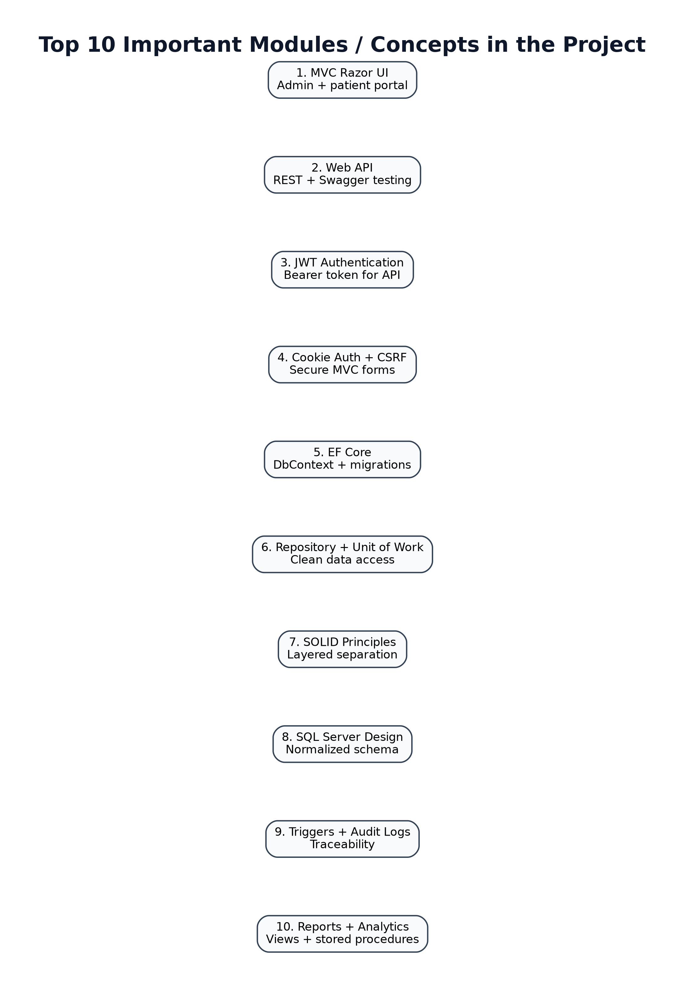
Healthcare Appointment & Care Analytics
Slide 18 / 18
18. Top 10 Modules & Q&A Readiness
Final technical summary and SME panel preparation checklist.
Top 10 Modules to explain
1. MVC routing, Razor Views, and ViewModels
2. Admin login, user registration, and role redirection
3. JWT token generation and Swagger Bearer testing
4. Patient profile creation with user-to-patient linking
5. Appointment booking with duplicate slot validation
6. EF Core DbContext and repository abstraction
7. SQL DDL, triggers, audit logs, views, stored procedures
8. Report service and analytics for appointment tracking
9. SOLID principles, DTOs, and clean layered architecture
10. Docker, GitHub Actions, and Azure deployment model (conceptual)
Closing message
This project demonstrates secure healthcare appointment management with MVC UI, JWT-secured API, SQL Server integration, audit logging, reporting, and cloud-ready architecture.
Capstone Final Presentation • ASP.NET Core MVC + Web API + SQL Server
Secure · Layered · Database-driven · API-ready

